Slide 1

Hoarding Advertising

Slide 2

Available Hoardings Proposal

Slide 3
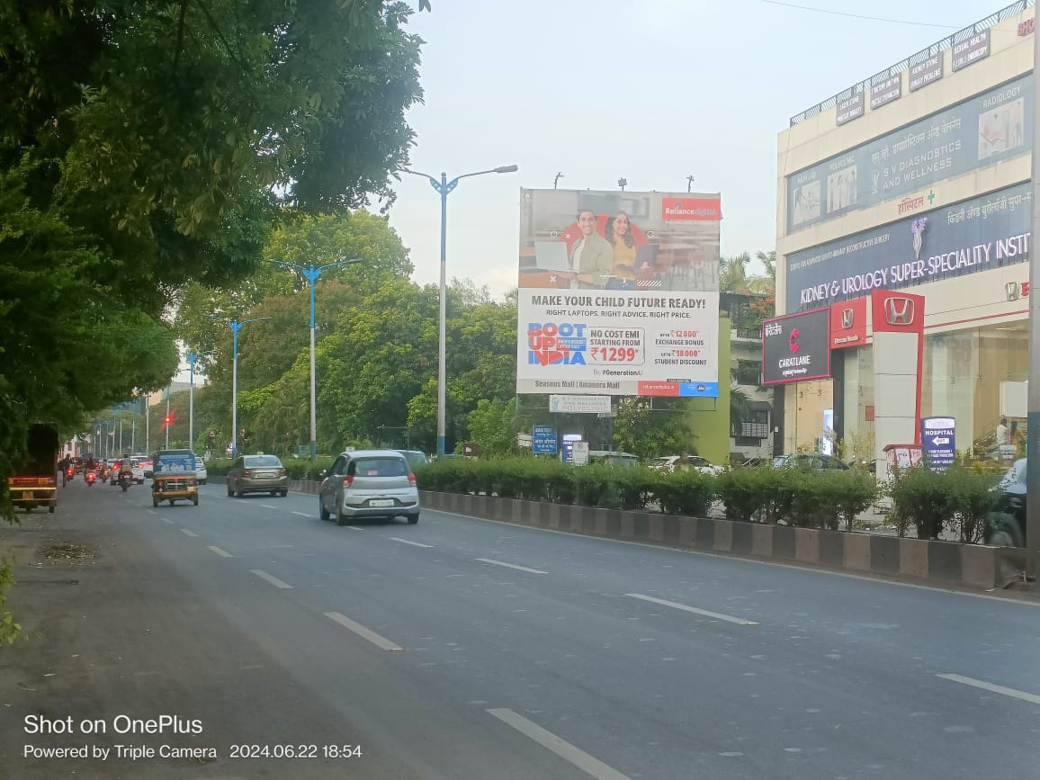
Magarapatta IT Park Road At Blue Stone & P N G Jewellers 30x30 Front Lit FCG Hadapsar To Amanora Mall & Kharadi

Slide 4
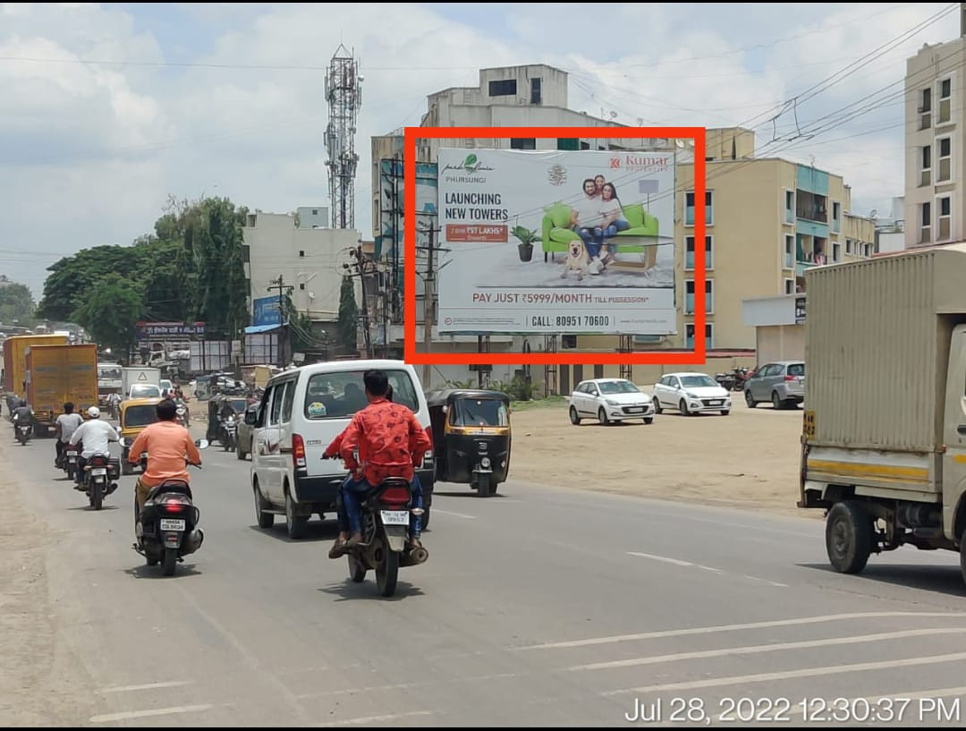
Size: 40×30 (Ft) , Opposite Vitthal HP Petrol Pump Traffic from Powerhouse to Hadapsar, Bhekrai Nagar Phursungi.

Slide 5
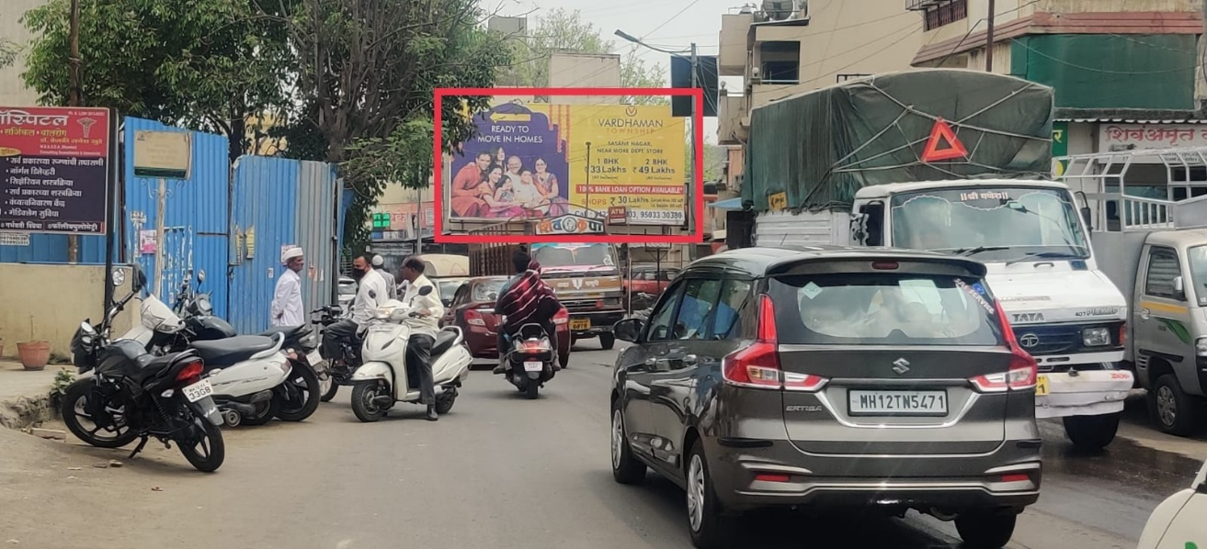
Size:30×15 near Mohamadwadi junction, Traffic from Corianthans to Hadapsar and Shriram Chowk Kalepadel.

Slide 6
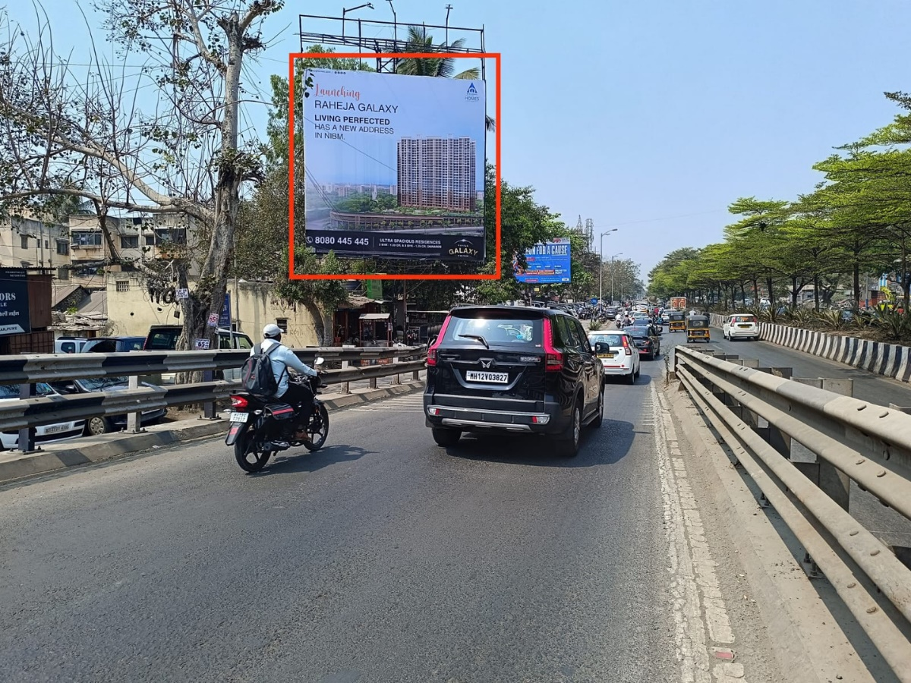
Hadapsar road near Ranka Jewellers facing Magarpatta to Fatimanagar.
Size 30x30 (Lit)

Slide 7
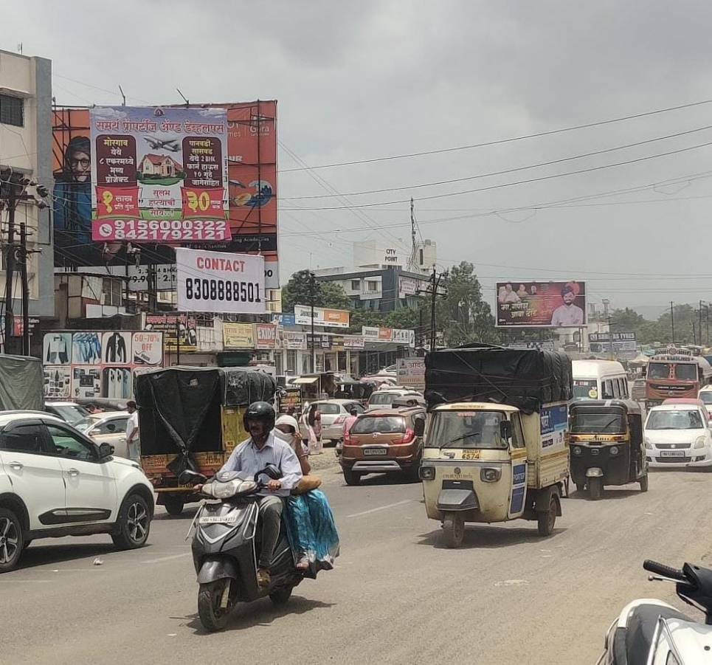
Size:20×20 Opposite Vitthal HP Petrol Pump,(Traffic from IBM to Powerhouse) Pune- Saswad Road, Bhekrai Nagar, Phursungi.

Slide 8
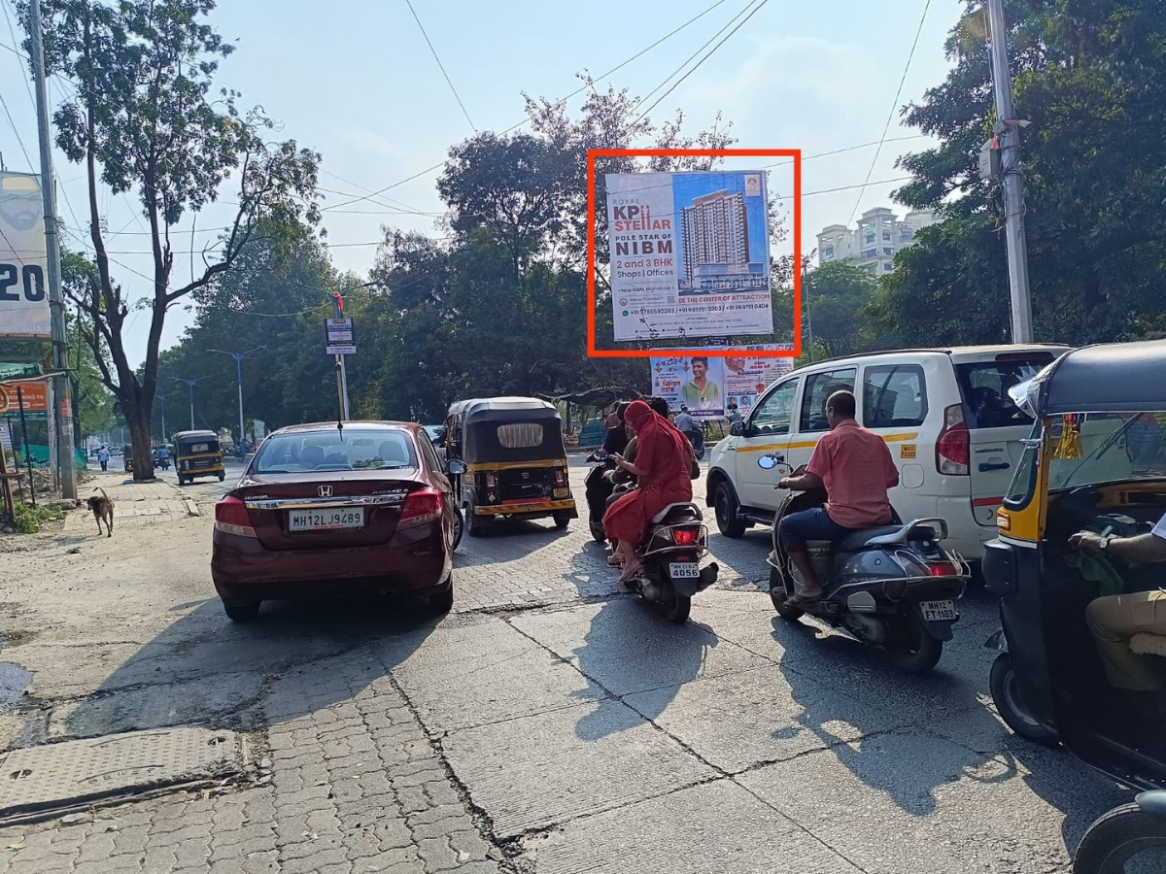
Wanorie Kedari Nagar Junction outside Secret heart town & Aprilla Showroom to Nibm Cloud9. Size 30x25 (N.lit)

Slide 9
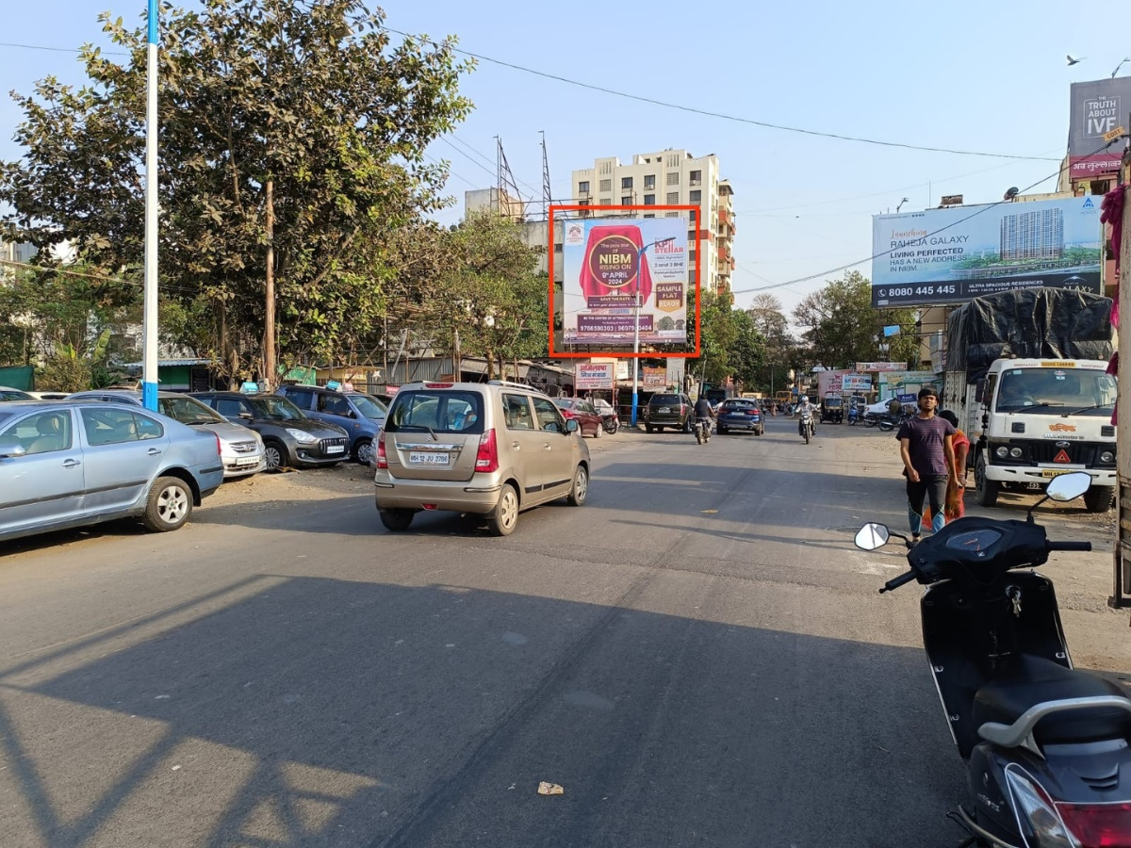
Wanorie Savidhan Chowk facing Fatimanagar to Nibm Cloud9. Size 30x30 (Lit).

Slide 10
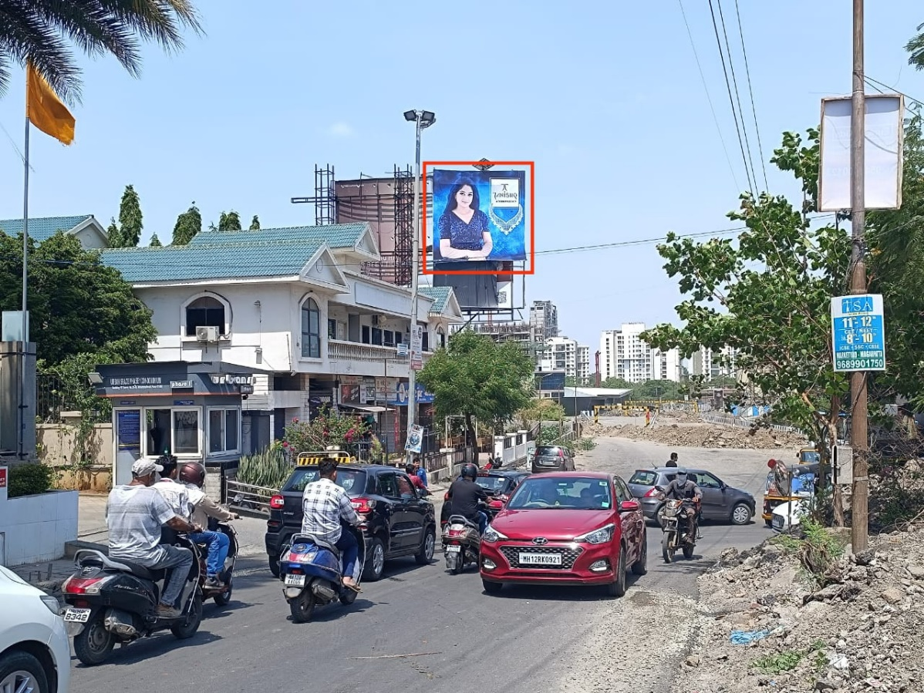
Nibm Cloud9 near Dorabjee Mall facing Nibm to Undri. Size 20x20 (N.lit)

Slide 11
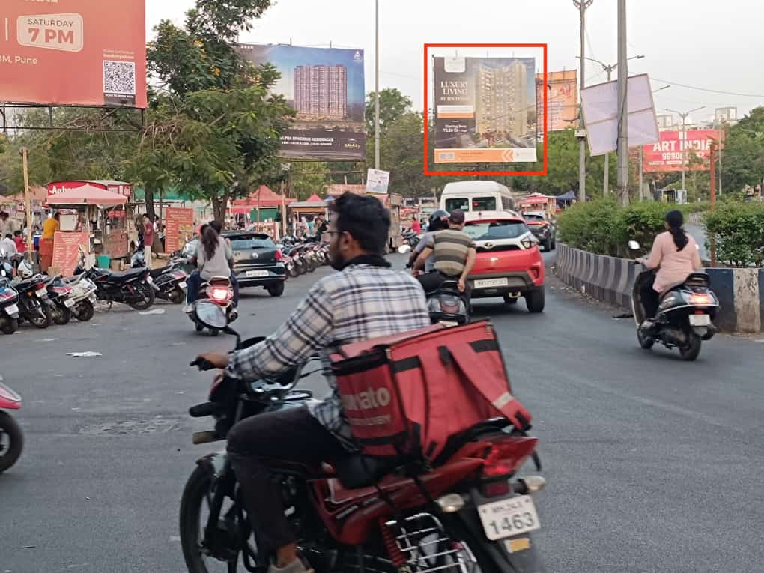
Savidhan Chowk near Much more Mall kedari petrol pump to Salunki vihar/ Nibm. Size 30x30 (N.lit) Available from 1st July.

Slide 12
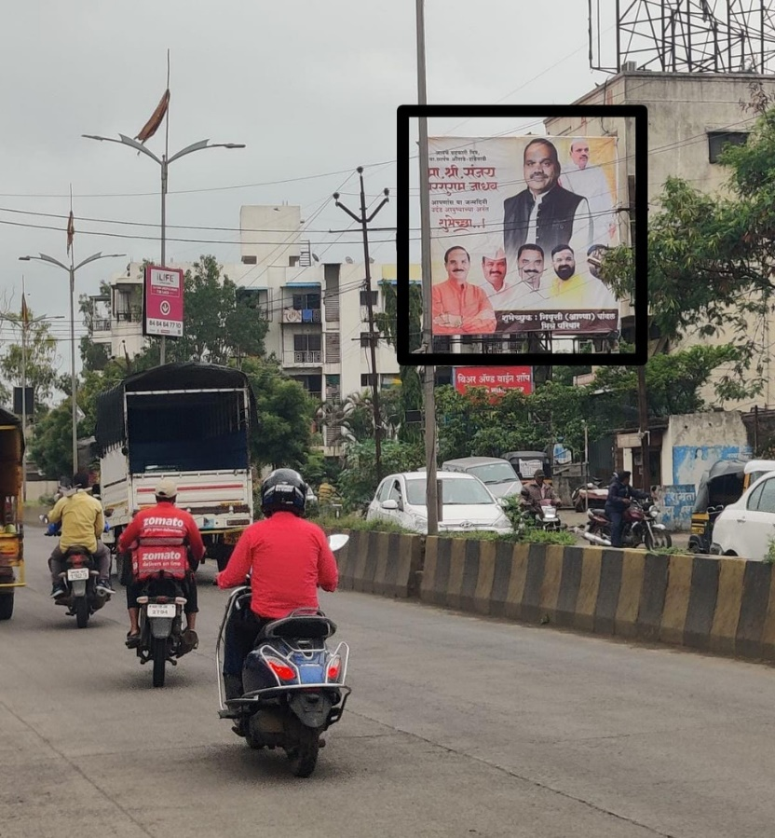
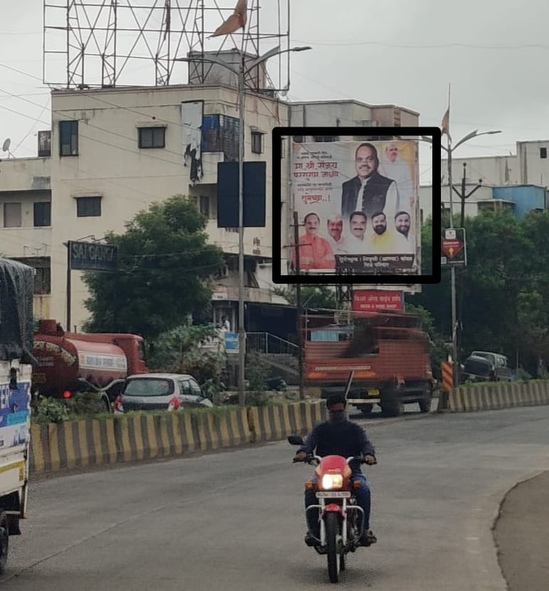
Size 20×20 Opposite Rajashri Shahu Bank, before Undri Chowk (150 meters) Traffic from Handewadi To Undri. (Back to Back)

Slide 13
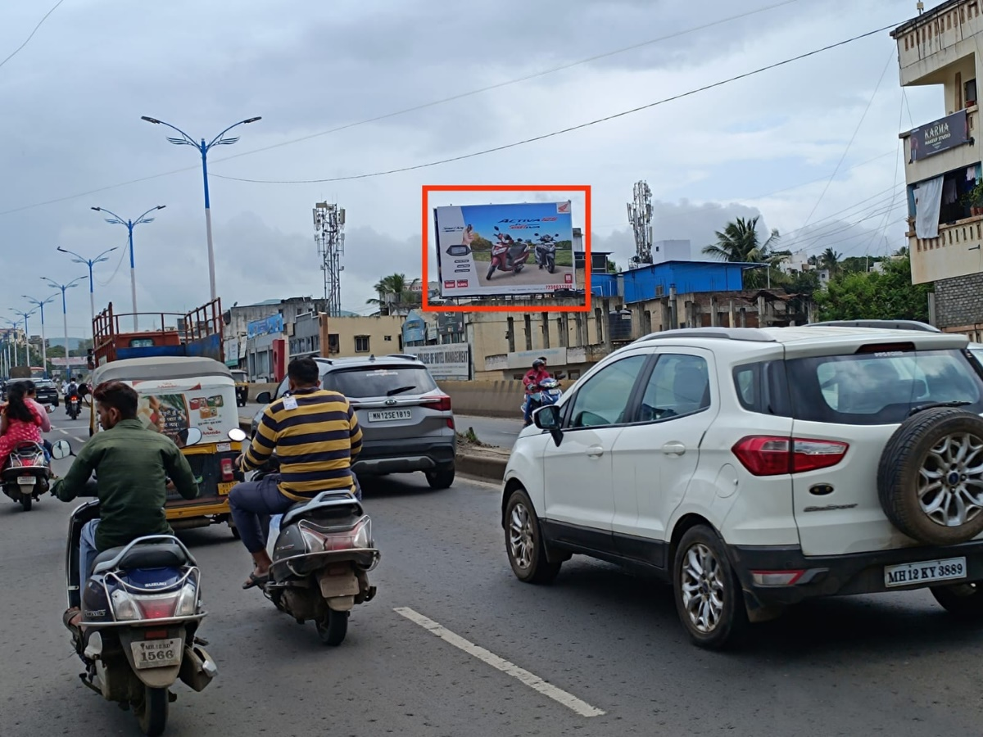
Dhankawadi Flyover Opp Alora Palace facing City pride to Katraj. Size 30x20 (N.lit)

Slide 14
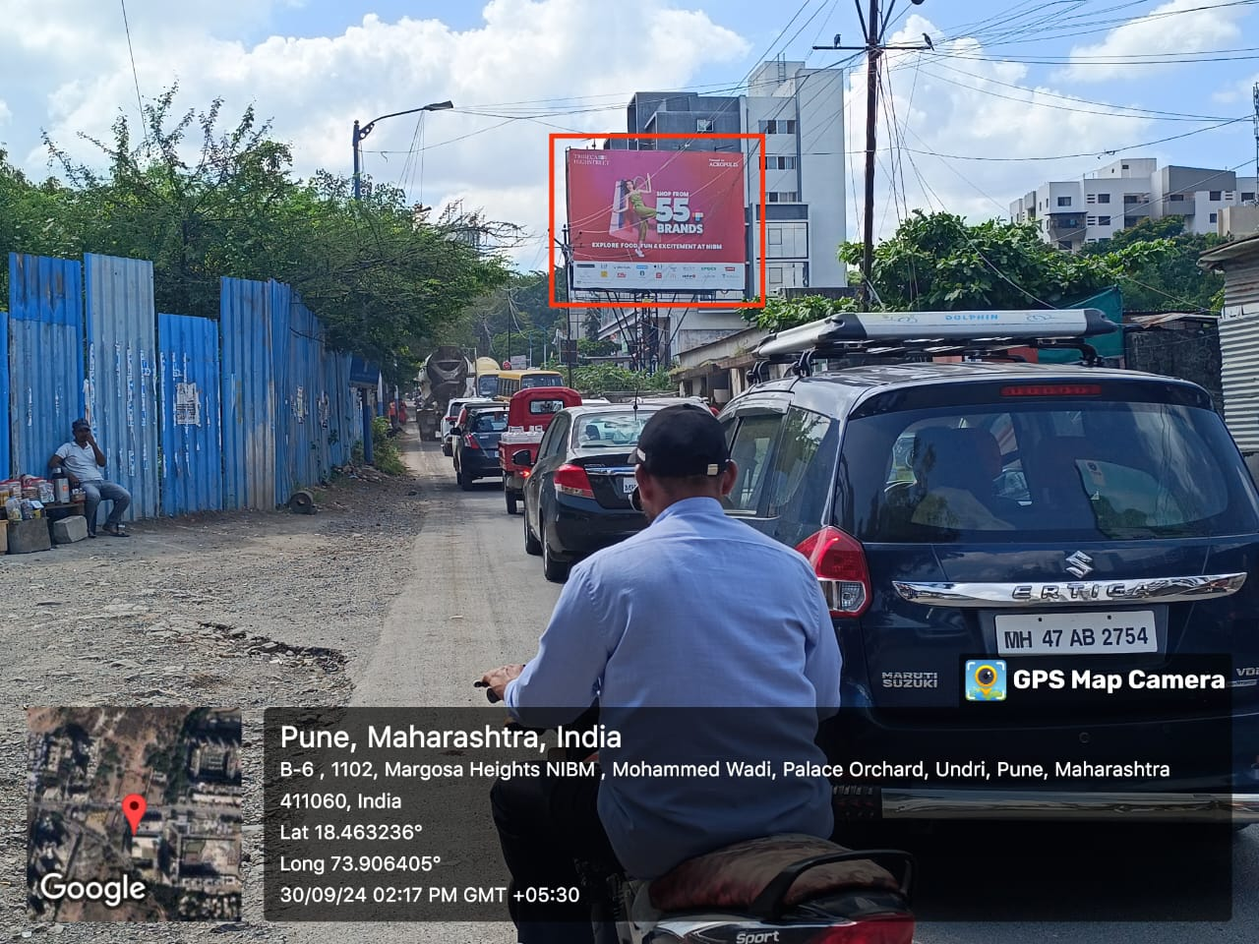
Nibm Orchard Palace opp Zudio Mall facing Corianthan club to Nibm. Size 40x30 (Lit) Immediate Available

Slide 15
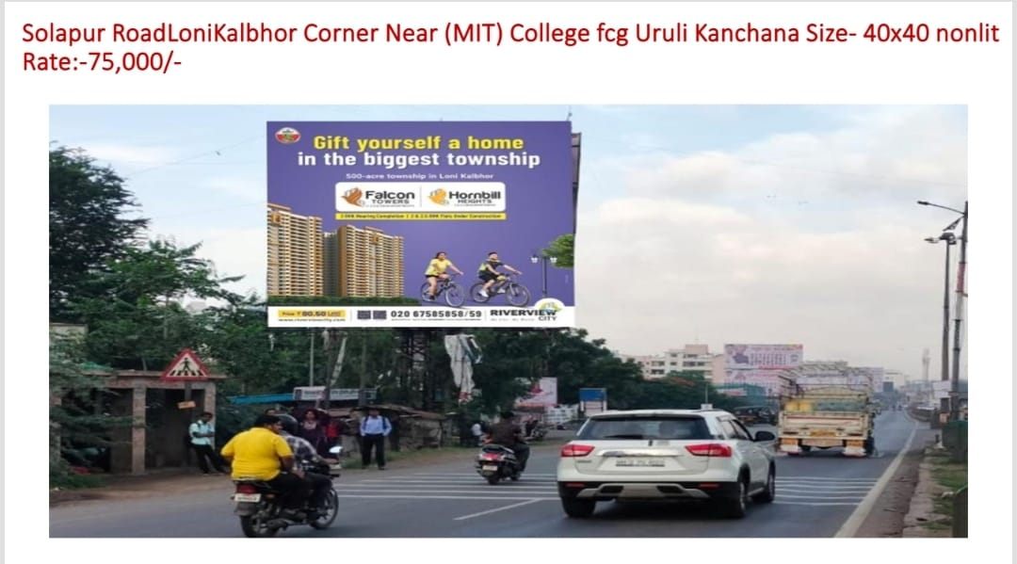
Solapur RoadLoni Kalbhor Corner Near (MIT) College fcg Uruli Kanchana Size- 40x40 nonlit

Slide 16
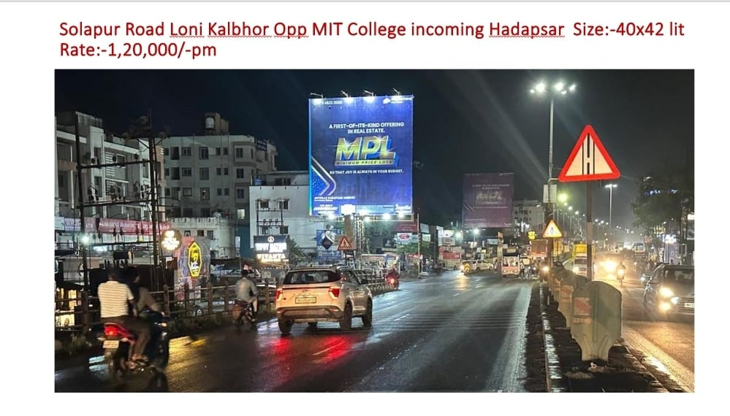
Solapur Road Loni Kalbhor Opp MIT College incoming Hadapsar Size:-40x42 lit

Slide 17
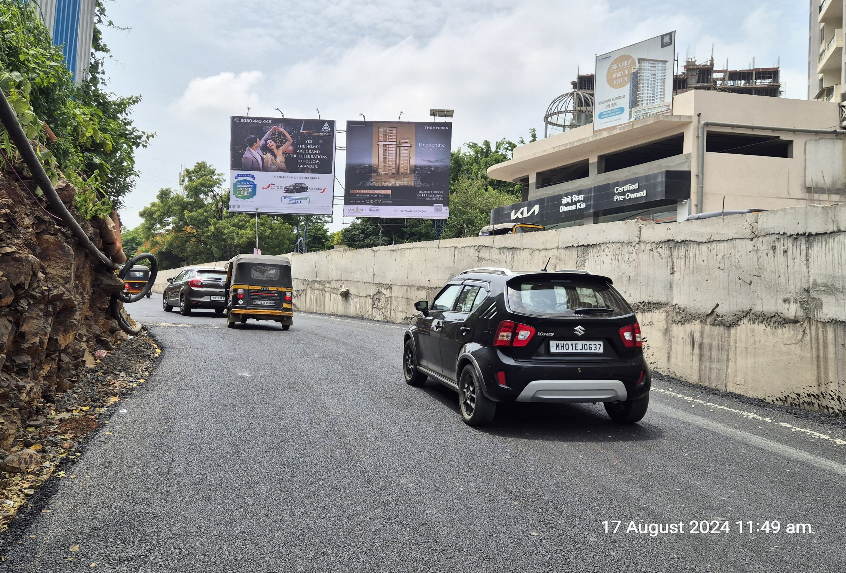
NIBM KONDHWA TO UNDRI OPP CLOVER MALL NR GOLD GYM TRAFFIC TOWARDS UNDRI AND CORIANTHIANS CLUB RHS
SIZE : 30’ X 30’ FRONT LIT AVAILABLE :- Immediate

Slide 18
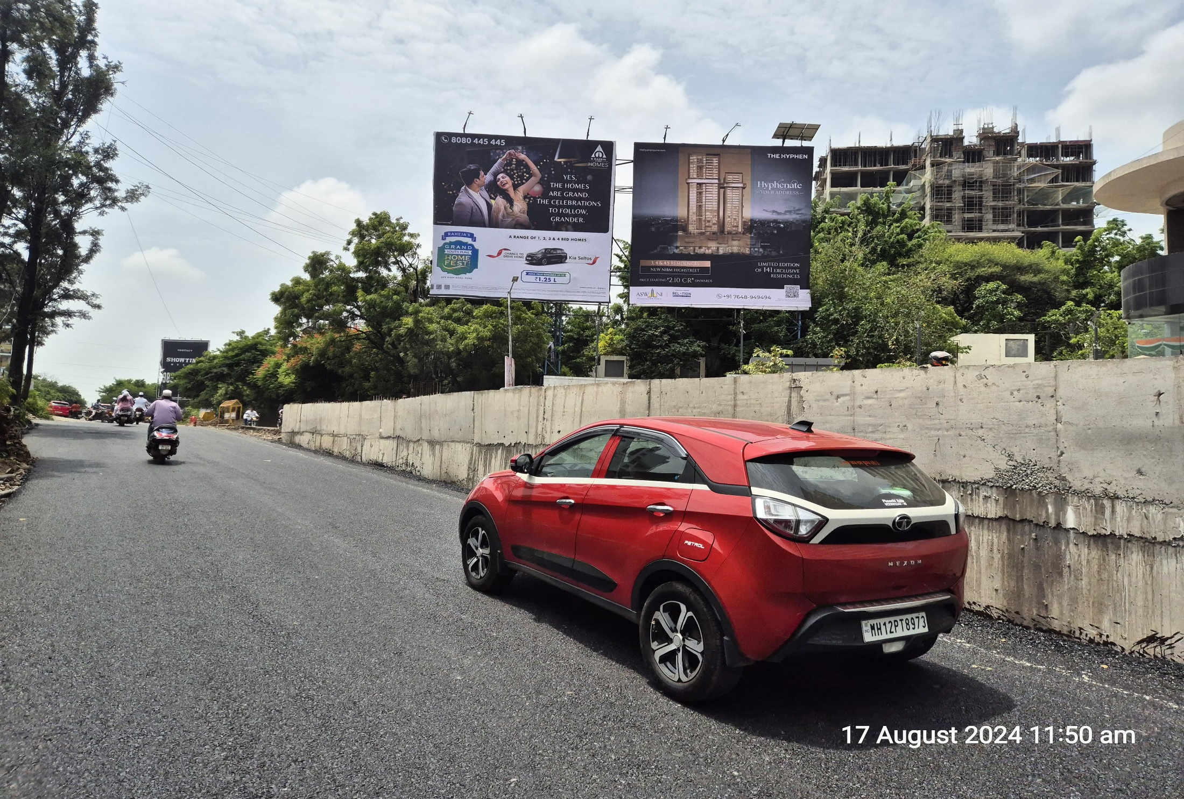
NIBM KONDHWA TO UNDRI OPP CLOVER MALL NR GOLD GYM TRAFFIC TOWARDS UNDRI AND CORIANTHIANS CLUB LHS
SIZE : 30’ X 30’ FRONT LIT AVAILABLE :- 30/10/2024

Slide 19
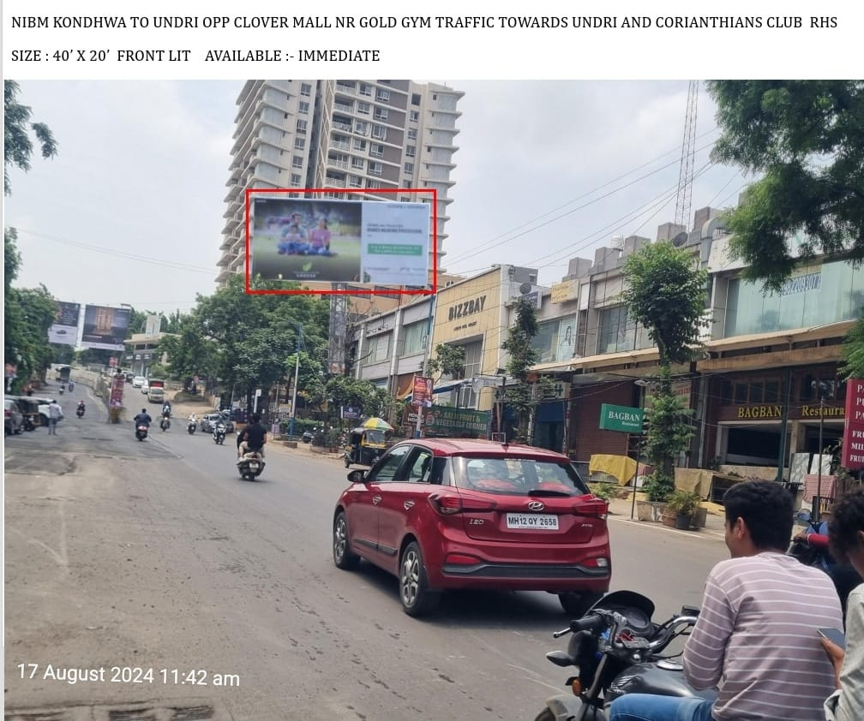
NIBM KONDHWA TO UNDRI OPP CLOVER MALL NR GOLD GYM TRAFFIC TOWARDS UNDRI AND CORIANTHIANS CLUB
SIZE : 40’ X 20’ FRONT LIT AVAILABLE :- Immediate

Slide 20
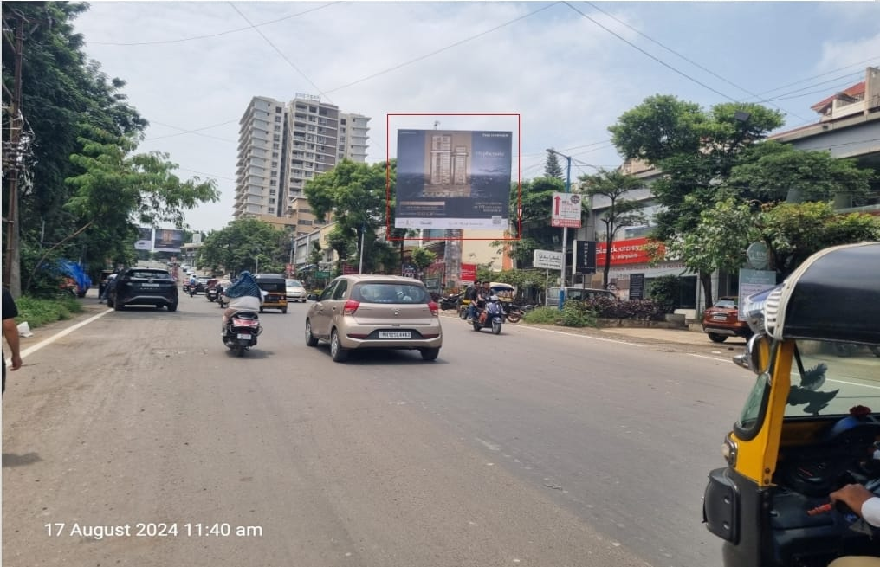
NIBM KONDHWA TO UNDRI OPP CLOVER MALL NR GOLD GYM TRAFFIC TOWARDS UNDRI AND CORIANTHIANS CLUB
SIZE : 30’ X 30’ FRONT LIT AVAILABLE :- IMMEDIATE

Slide 21
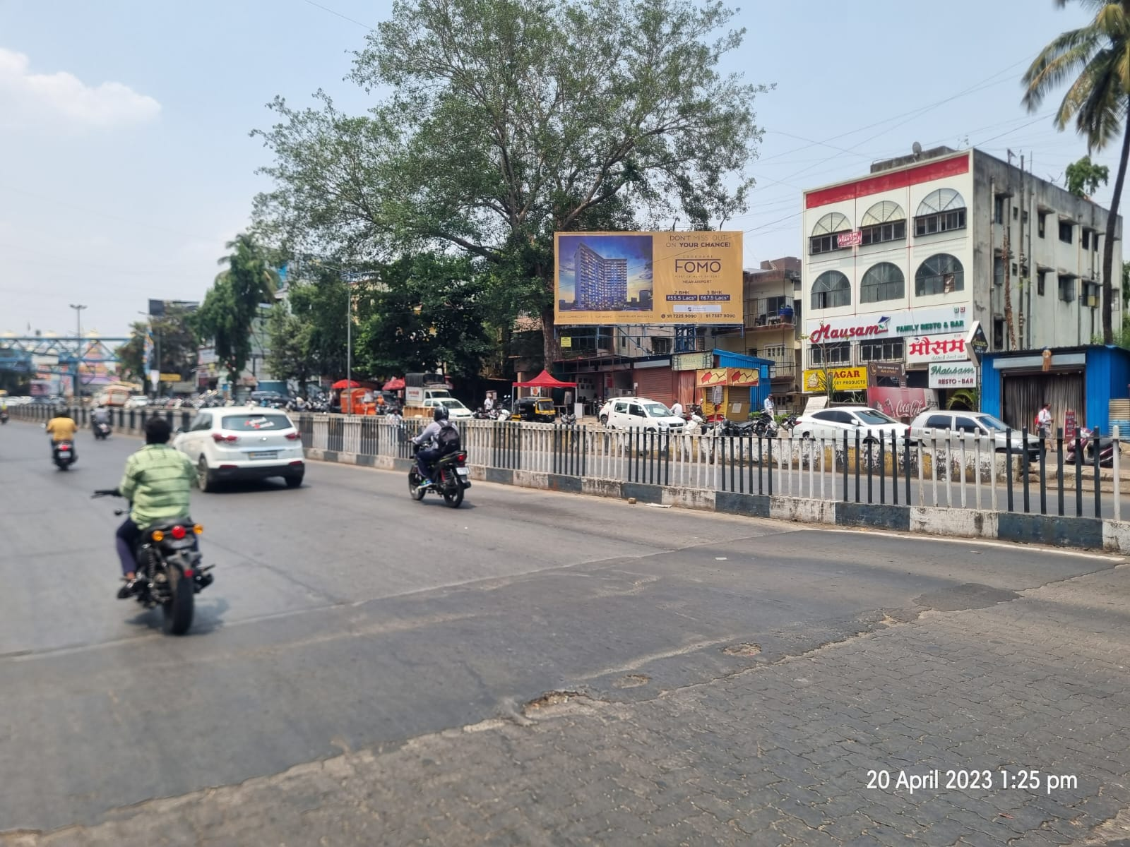
VISHRANTWADI MAIN CHOWK FACING YERWADA TOWARDS DHANORI AND AIRPORT SIZE : 40’ X 20’ FRONT LIT
AVAILABLE : IMMEDIATE

Slide 22
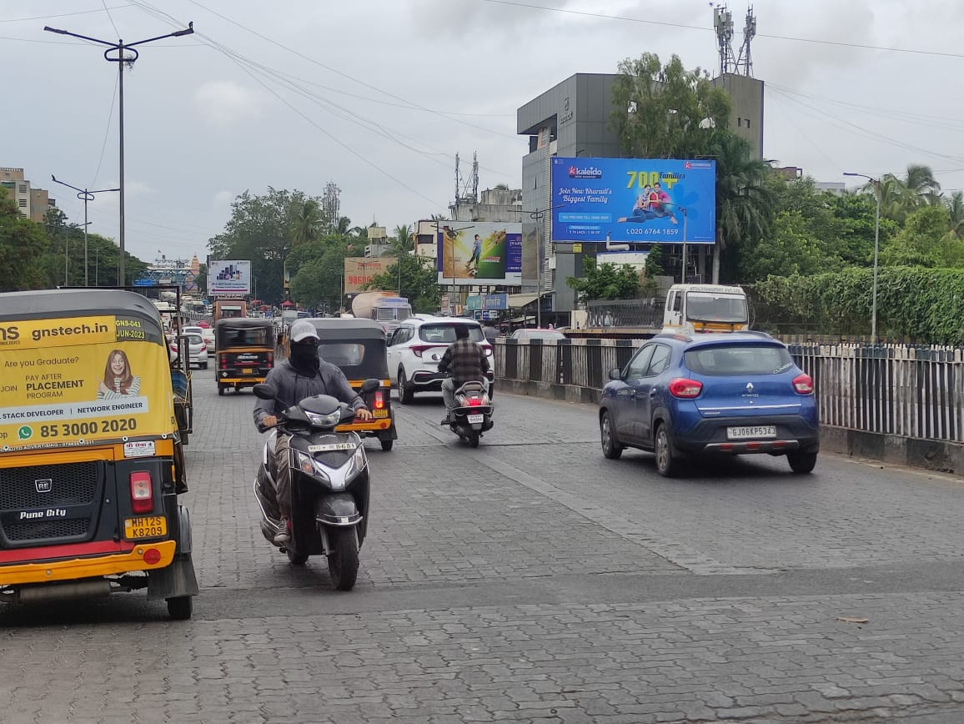
VISHRANTWADI OPP BIG BAZAAR FACING YERWADA TOWARDS DHANORI AND AIRPORT SIZE : 40’ X 20’ NON LIT
AVAILABLE :- 30/10/2024

Slide 23
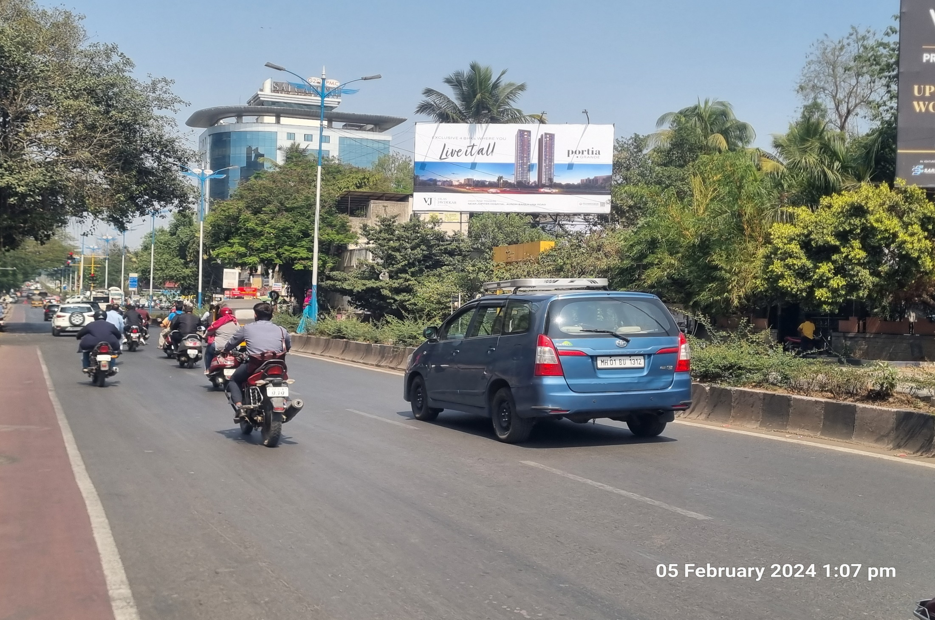
Senapati Bapat Road Nr. Hotel Marriott Facing Symbiosis & Low College Size : 40’ X 20’ (Front Lit)
Available :- 30/10/2024

Slide 24
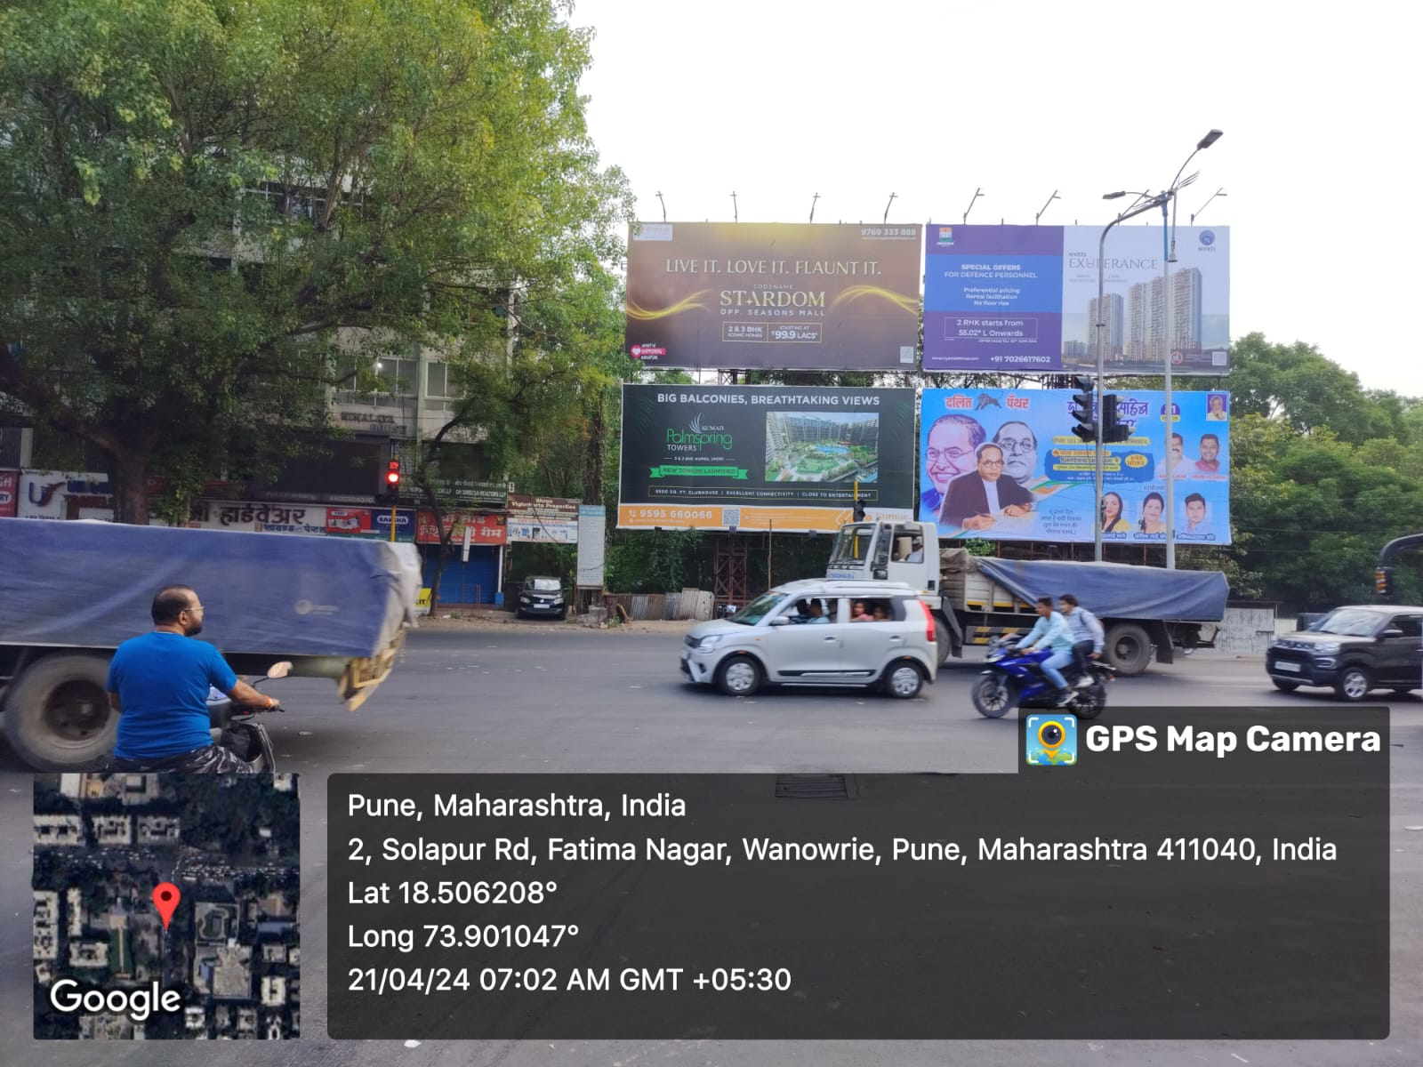
Fatima Nagar Main Chowk Facing Wanavadi Traffic Towards Camp & Hadapsar Size : 40’ X 20’ (Front Lit)
Available :- 15/10/2024

Slide 25
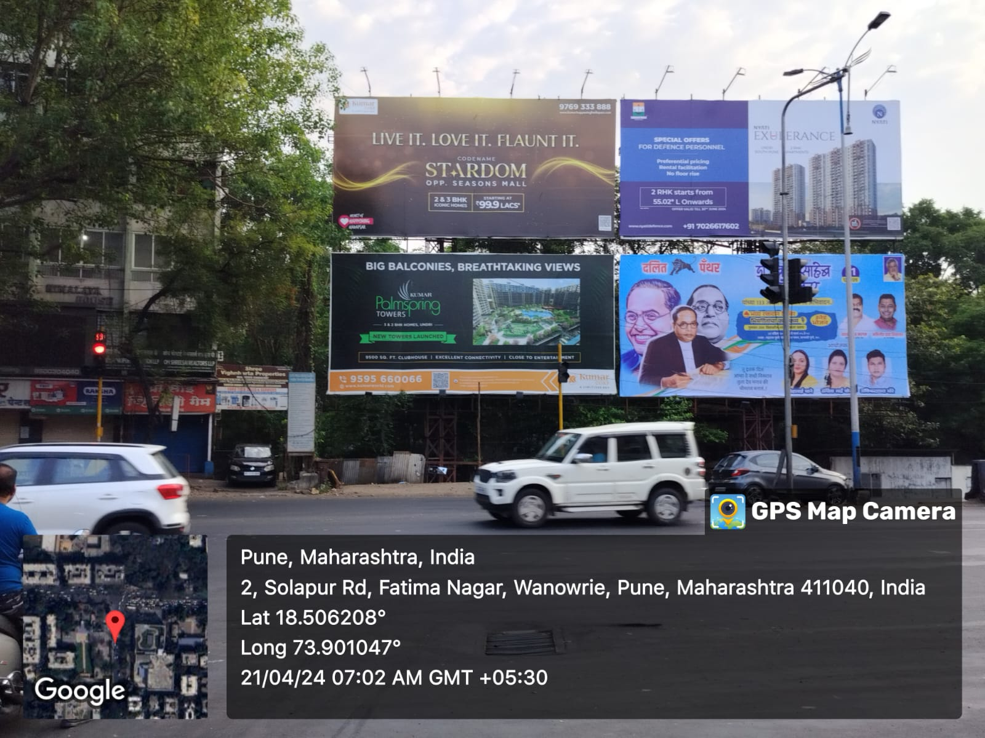
Fatima Nagar Main Chowk Facing Wanavadi Traffic Towards Camp & Hadapsar Size : 40’ X 20’ (Front Lit)
Available :- 30/10/2024

Slide 26
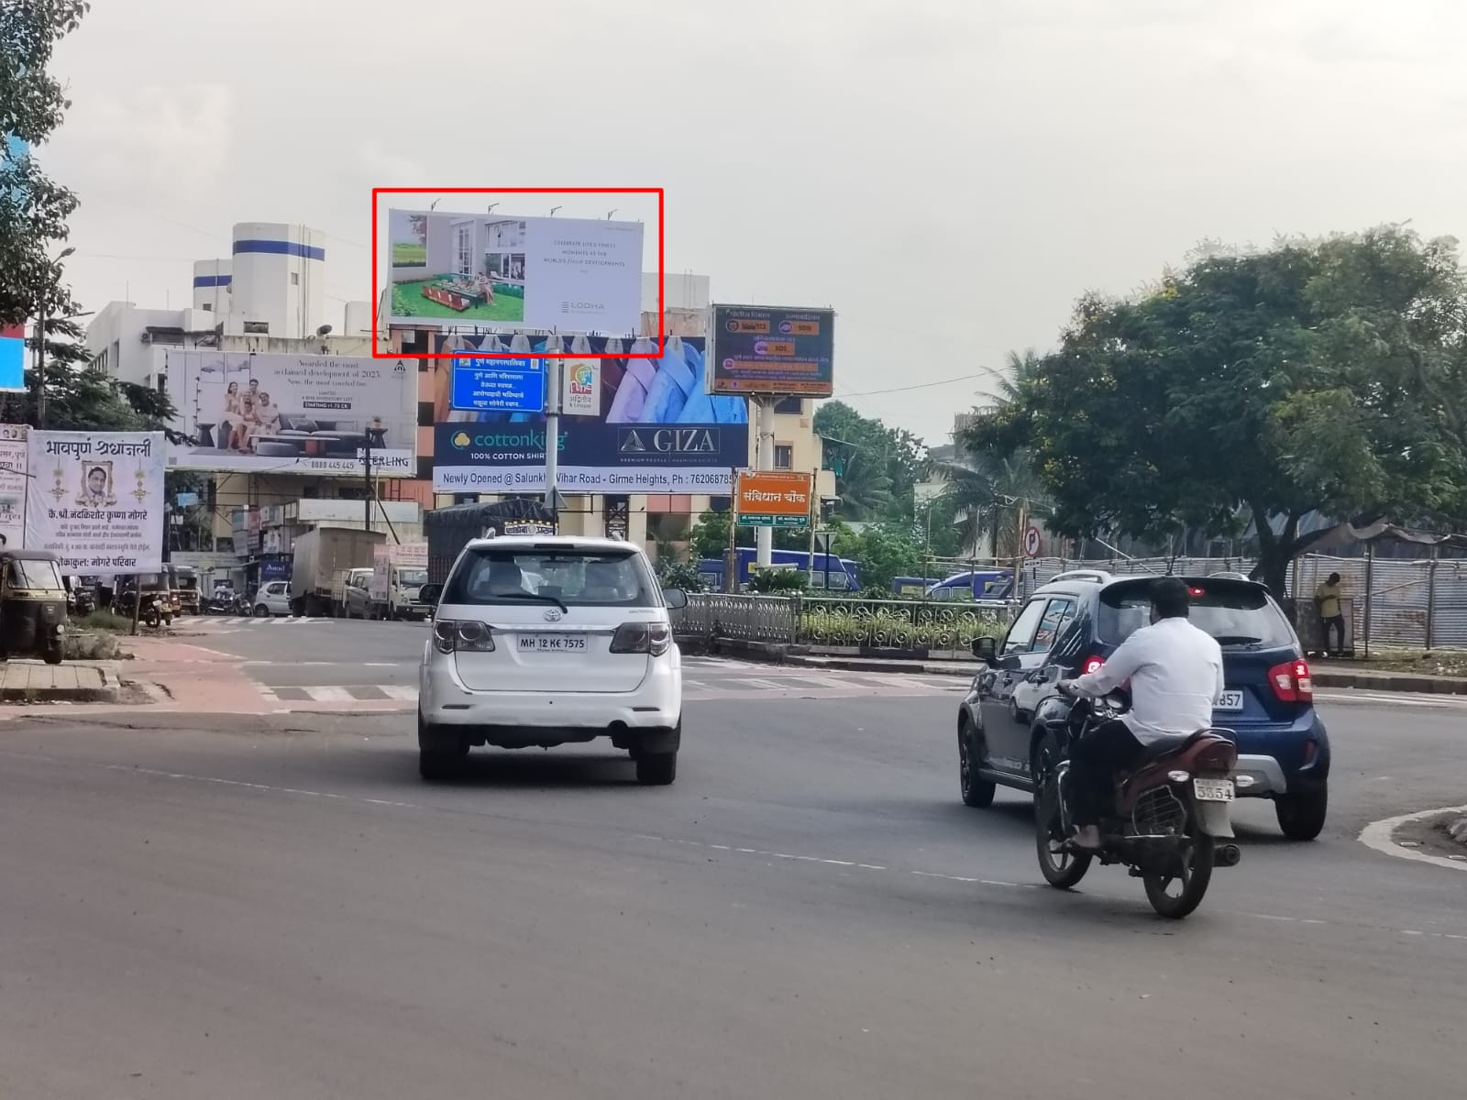
Fatimanagar To Salunke Vihar Road Sanvidhan Chowk Near Ruby Hall Wanavadi Size : 45’ X 20’ (Front Lit)
Available :- 05/10/2024

Slide 27
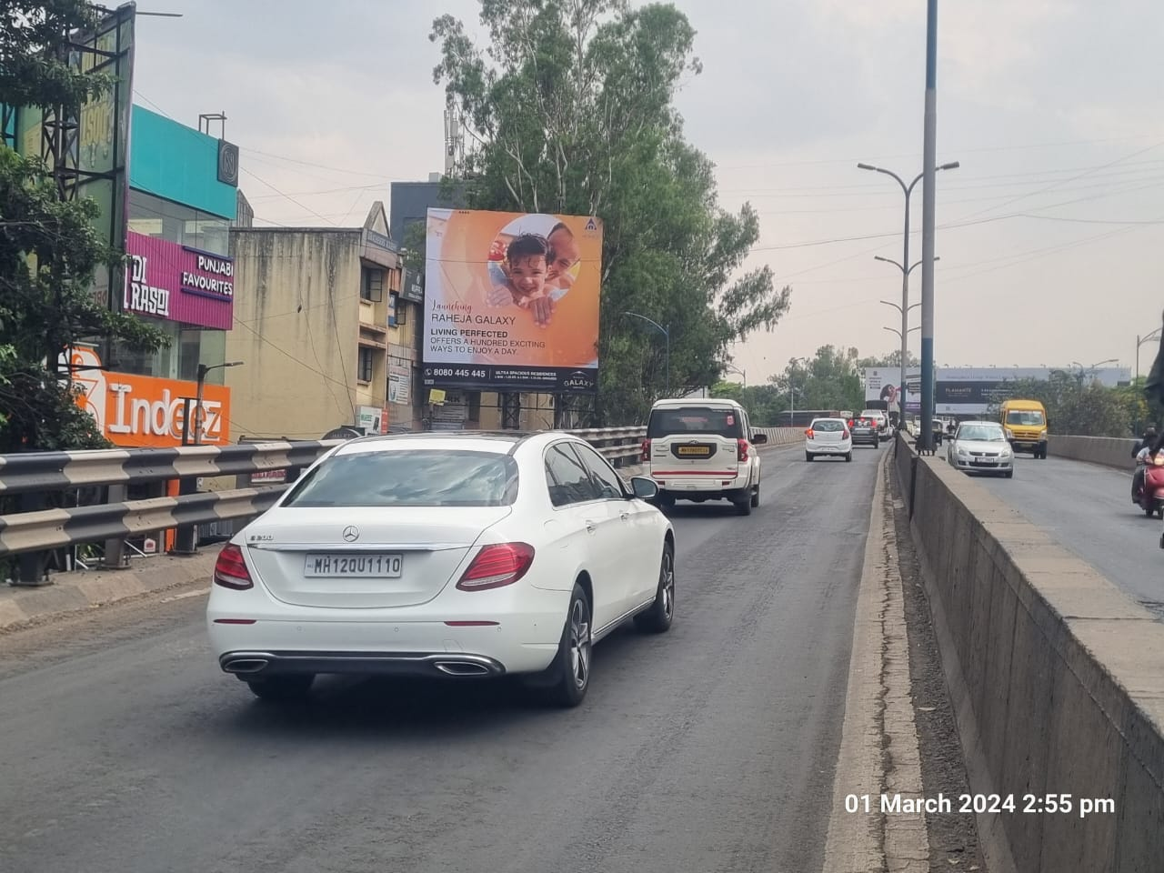
Magarpatta Opp Nobel Hospital, Facing Season Mall, ( Traffic Towards Hadapsar ) Size : 25’ X 25’ (Front Lit)
Available :- 30/10/2024

Slide 28
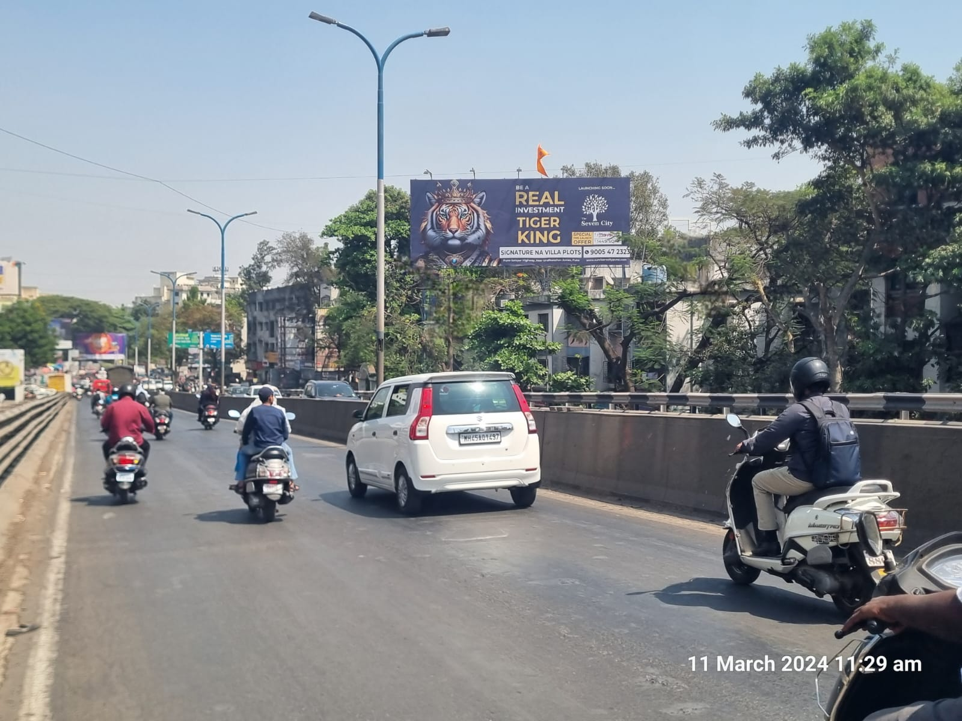
Magarpatta Opp Nobel Hospital, Facing Hadapsar, (Traffic Towards Season Mall) Size : 50’ X 20’ (Front Lit)
Available :- 22/10/2024

Slide 29
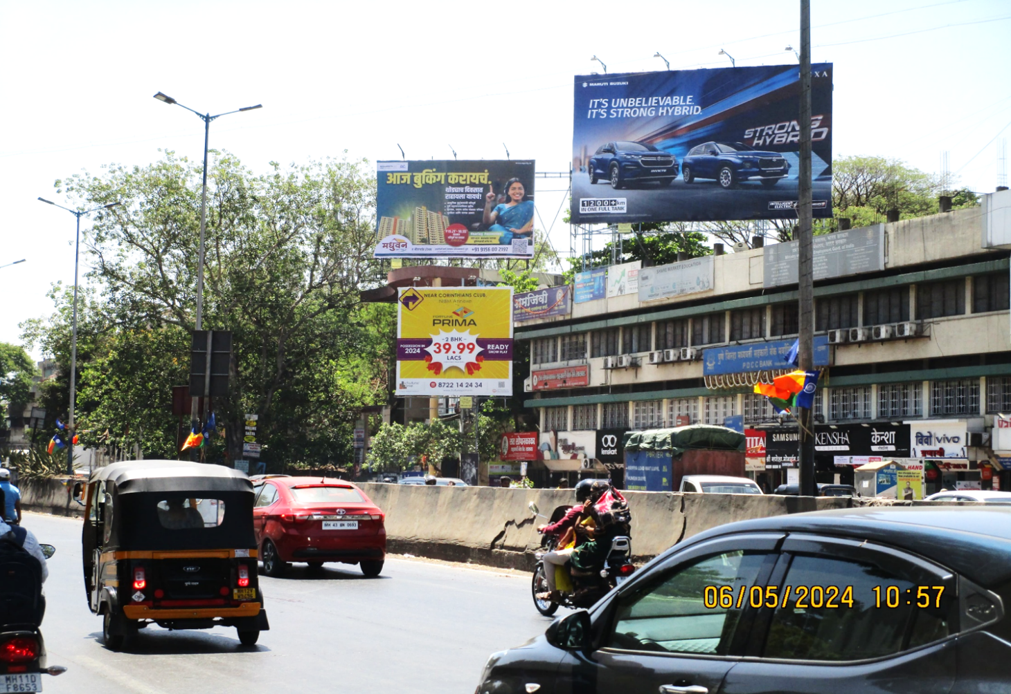
Hadapsar Near Vaibhav Theater Facing Magarpatta (Traffic Towards Loni) Size : 30’ X 20’ Non Lit
Available :- 05/11/2024

Slide 30
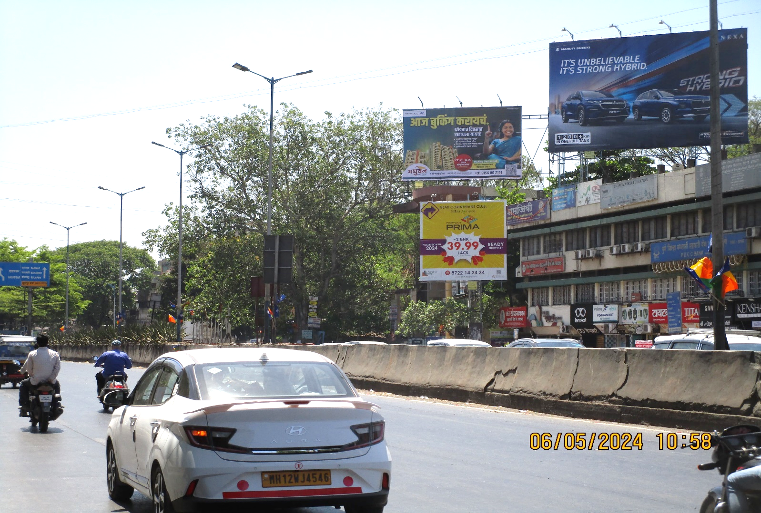
Hadapsar Near Vaibhav Theater Facing Fatima Nagar & Camp Size : 20’ X 20’ (Front Lit)
Available :- 13/10/2024

Slide 31
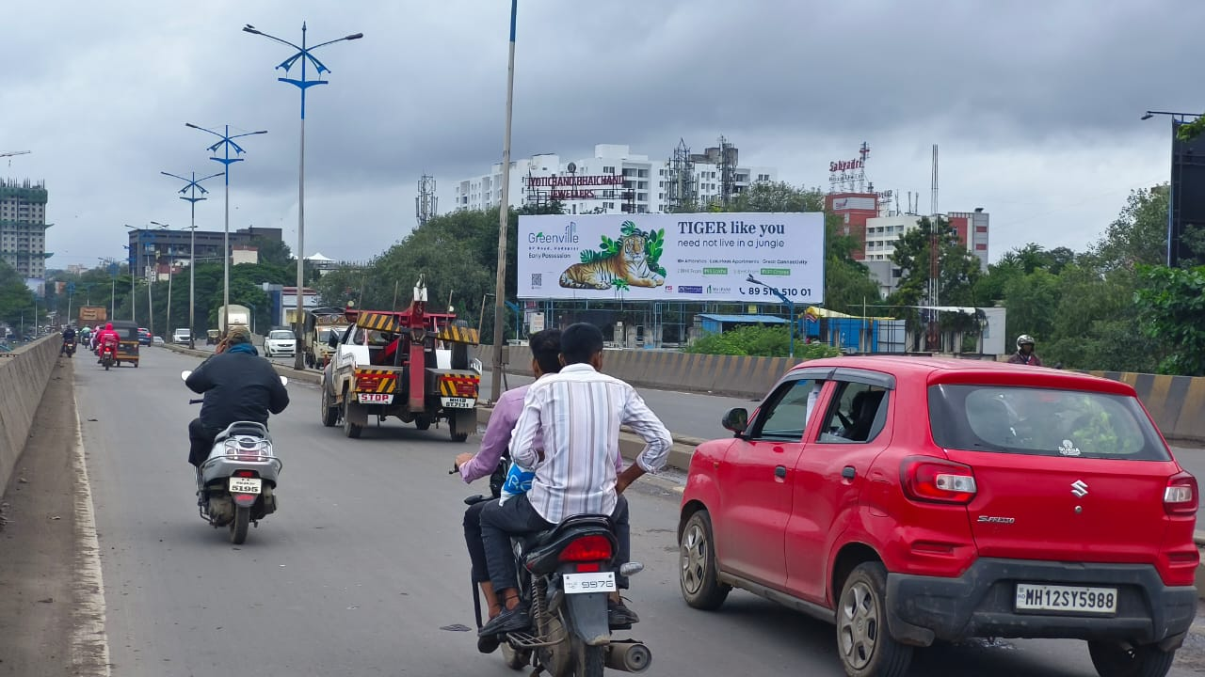
Hadapsar Gadital Bridge Traffic Towards Magarpatta & Fatima Nagar Size : 80’ X 20’ (Front Lit)
Available :- Immediate

Slide 32
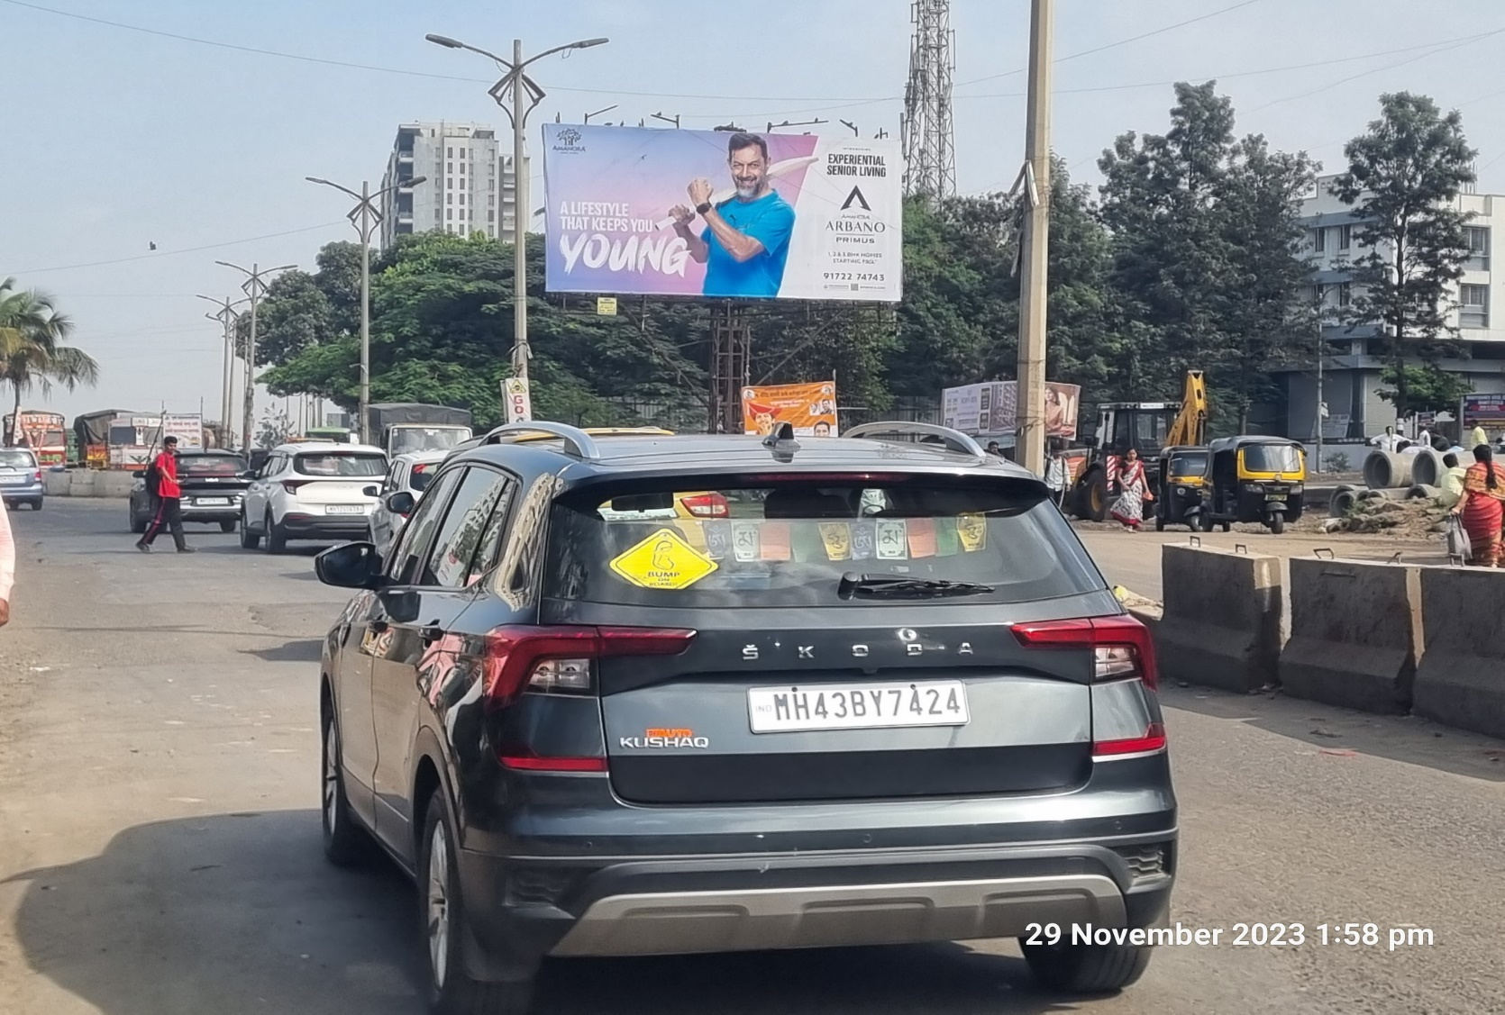
Katraj Kondhwa Road Facing Katraj Towards Khadi Mashin Opp Dominos Pizza Gokulnagar Size : 40’ X 30’,
Available :- Immediate

Slide 33
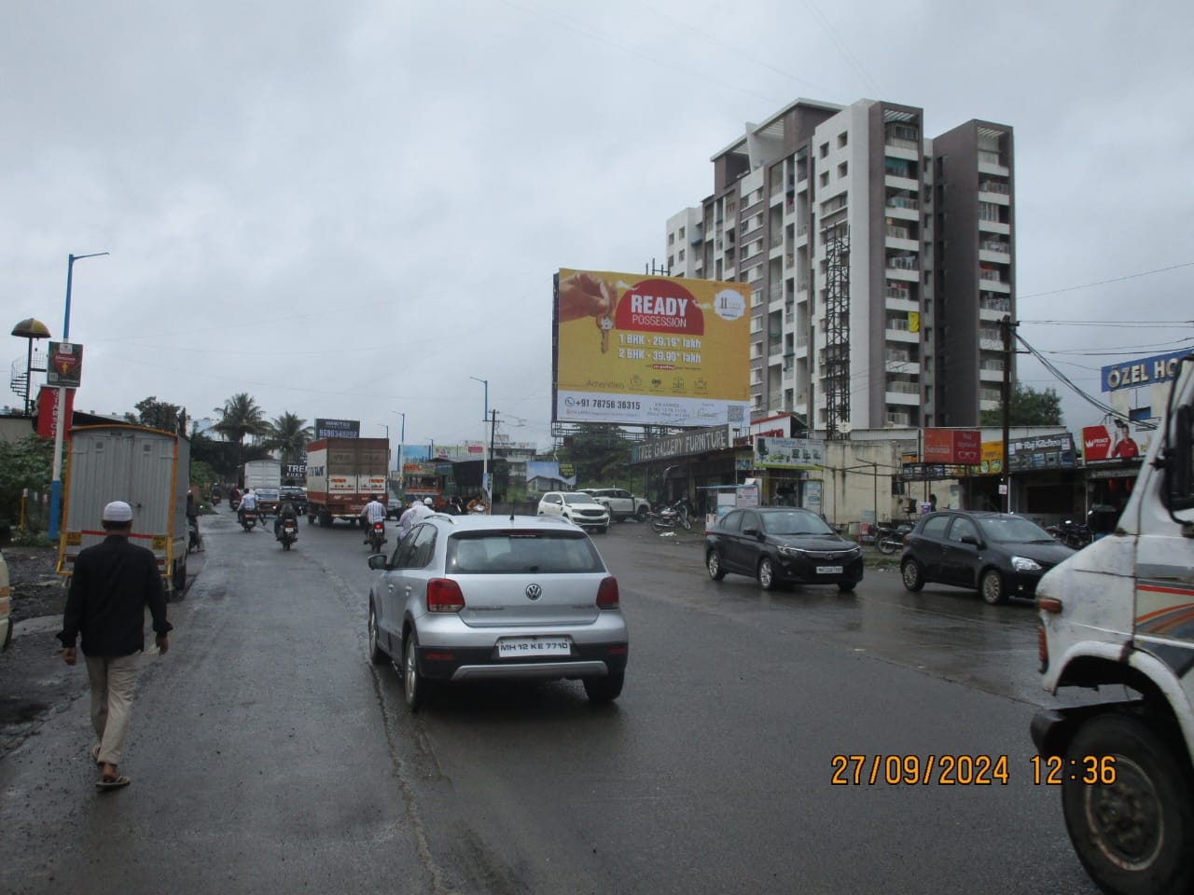
Pisoli Opp. Dharmavat Petrol Pump Facing Undri, Towards Khadimashin Chowk Size : 40’ X 30’,
Available :- 30/10/2024

Slide 34
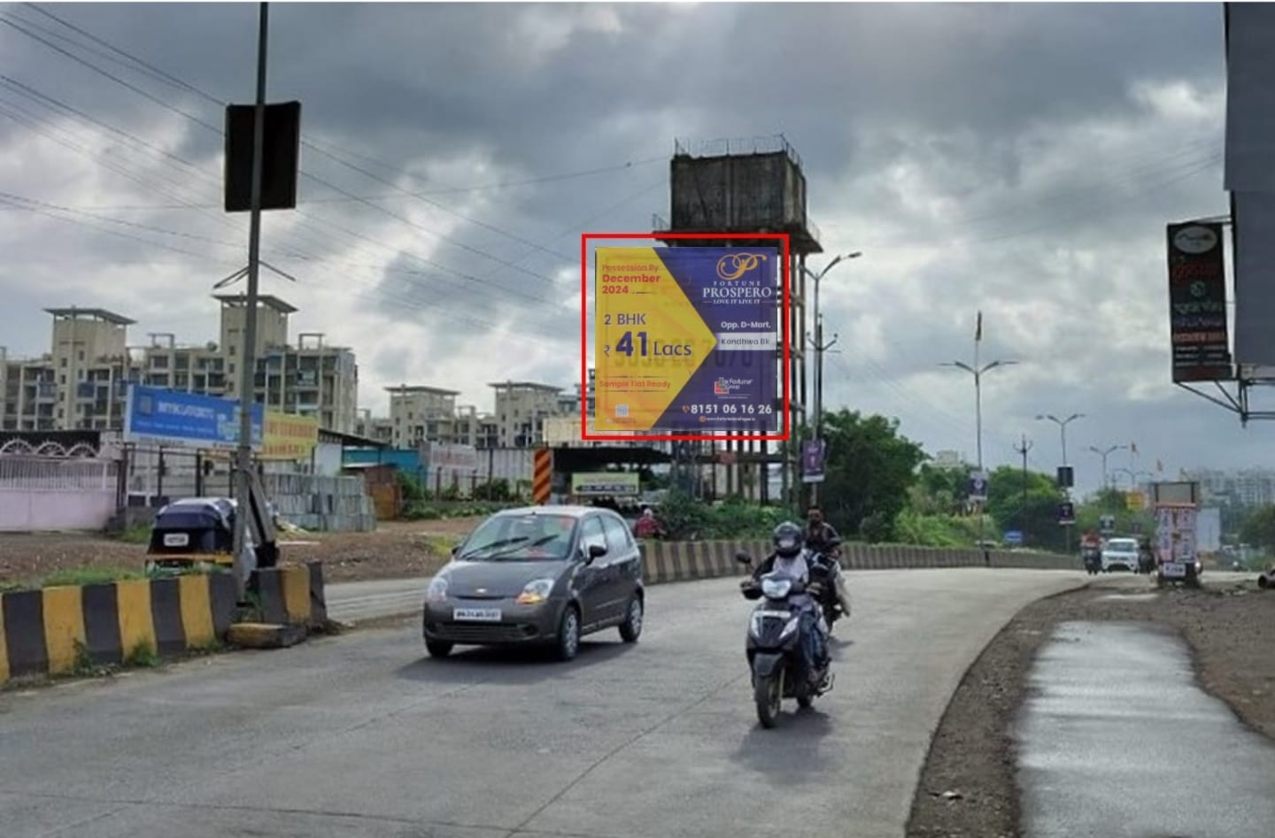
Undri Opp. Hotel Krishna & Vtp Urban Nest Facing Khadi Mashin (Traffic Towards Handewadi) Size: 30’ X 30’
Available:- Immediate

Slide 35
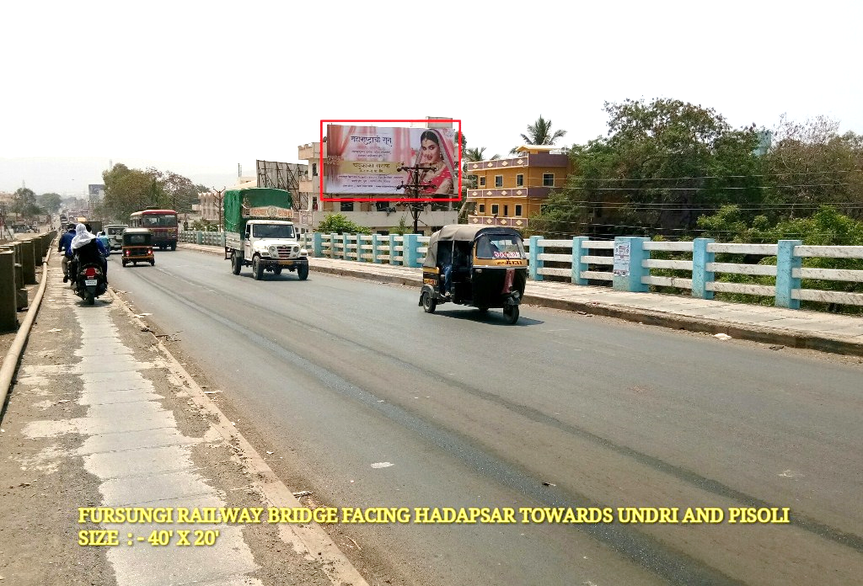
Fursungi Railway Bridge Traffic Towards Saswad & Undri Facing Hadapsar & Sp Infocity. Size : 40’ X 20’
Available :- Immediate

Slide 36
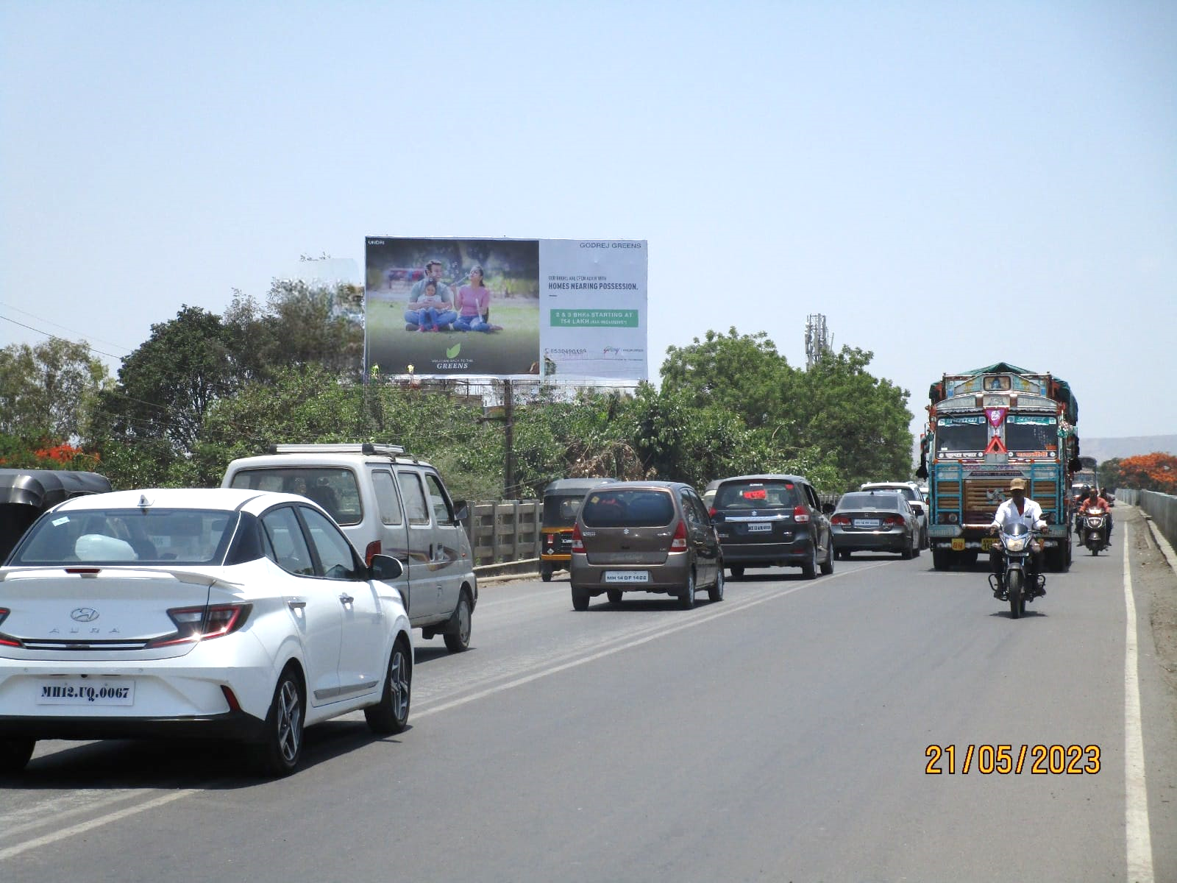
Fursungi Railway Bridge Traffic Towards Saswad & Undri Facing Hadapsar & Sp Infocity. Size : 40’ X 20’
Available : Immediate

Slide 37
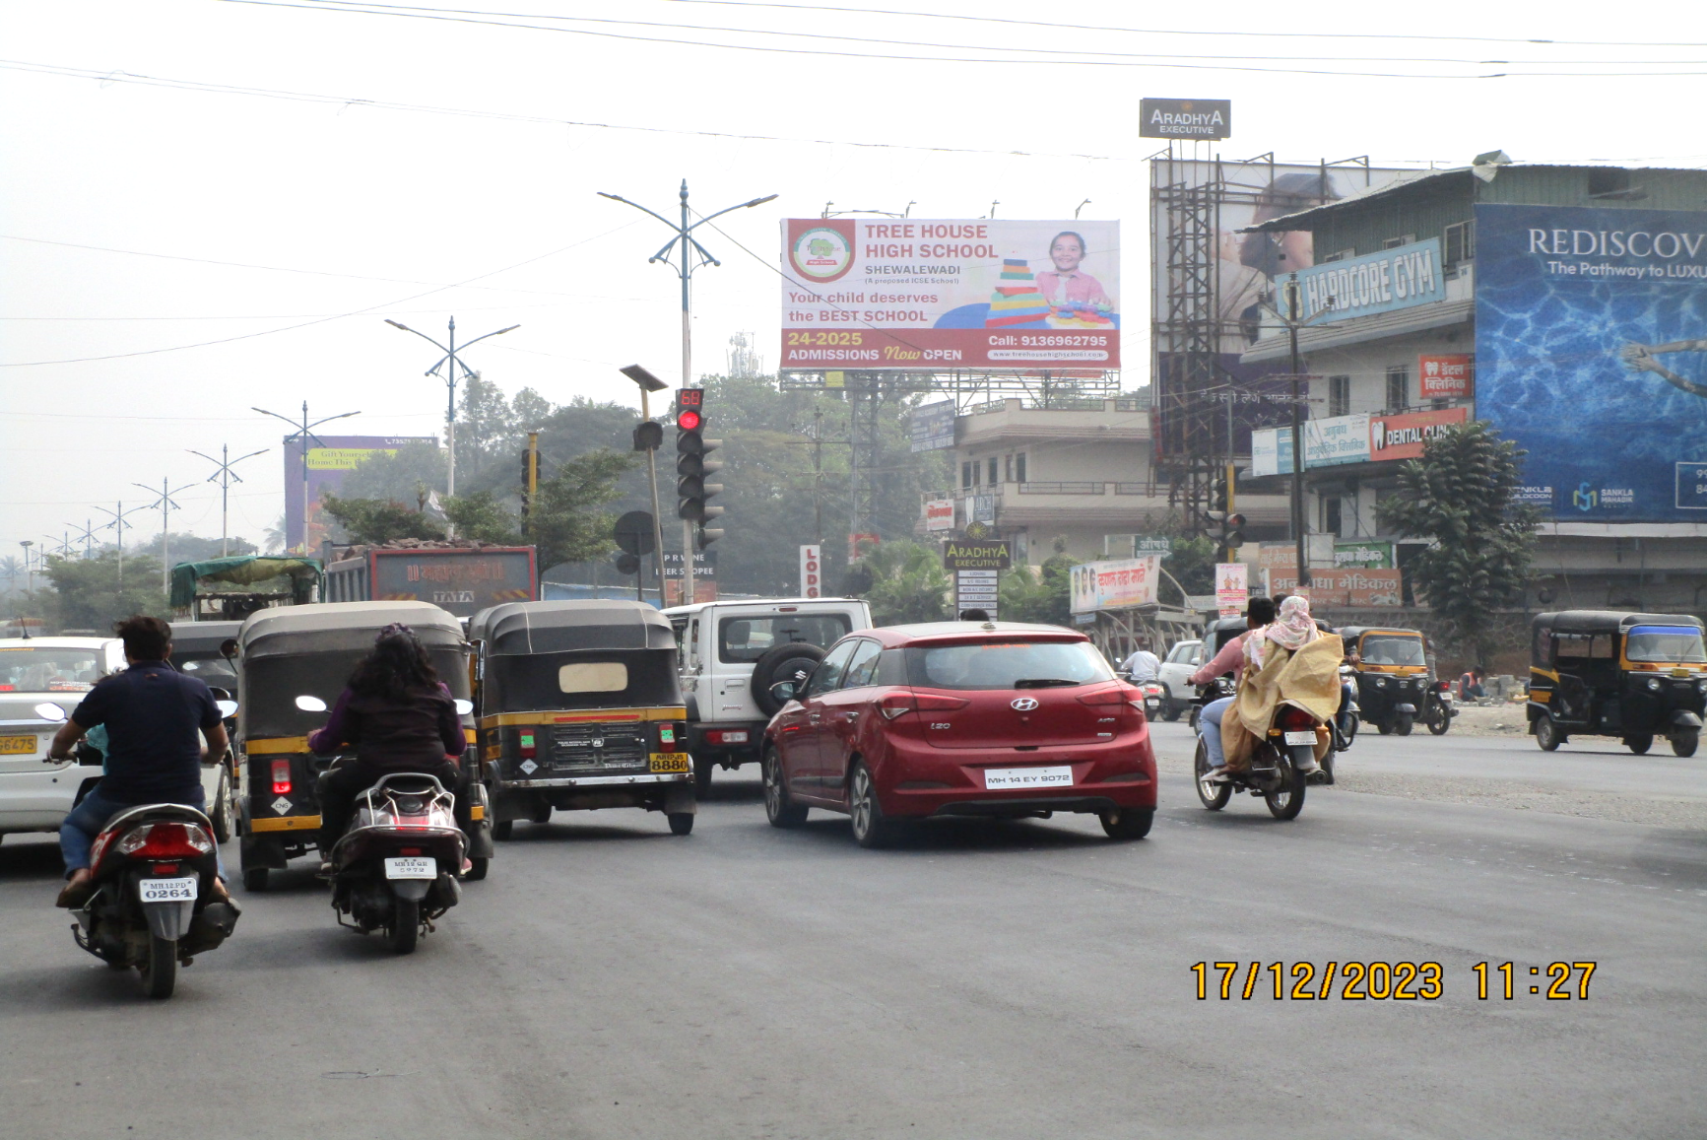
Solapur Road Manjari Shapoorji Joyville Gate Facing Hadapsar ( Traffic Towards Loni) Size : 40’ X 20’
Available:- Immediate (Front Lit )

Slide 38
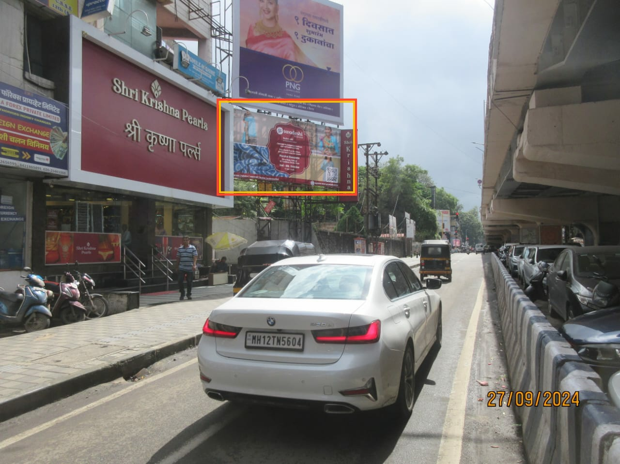
Karve Road Nalstop Chowk Fcg Deccan Towards Kothrud 20 X 10 Nl

Slide 39
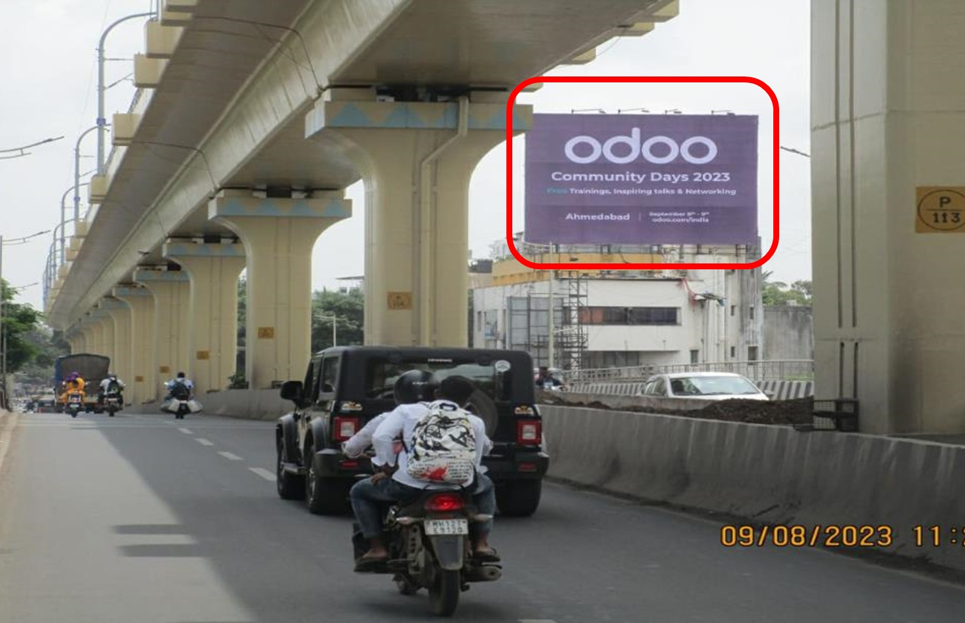
Karve Road Nalstop Chowk Fcg Kothrud Towards Deccan 40 X 20 Lit

Slide 40
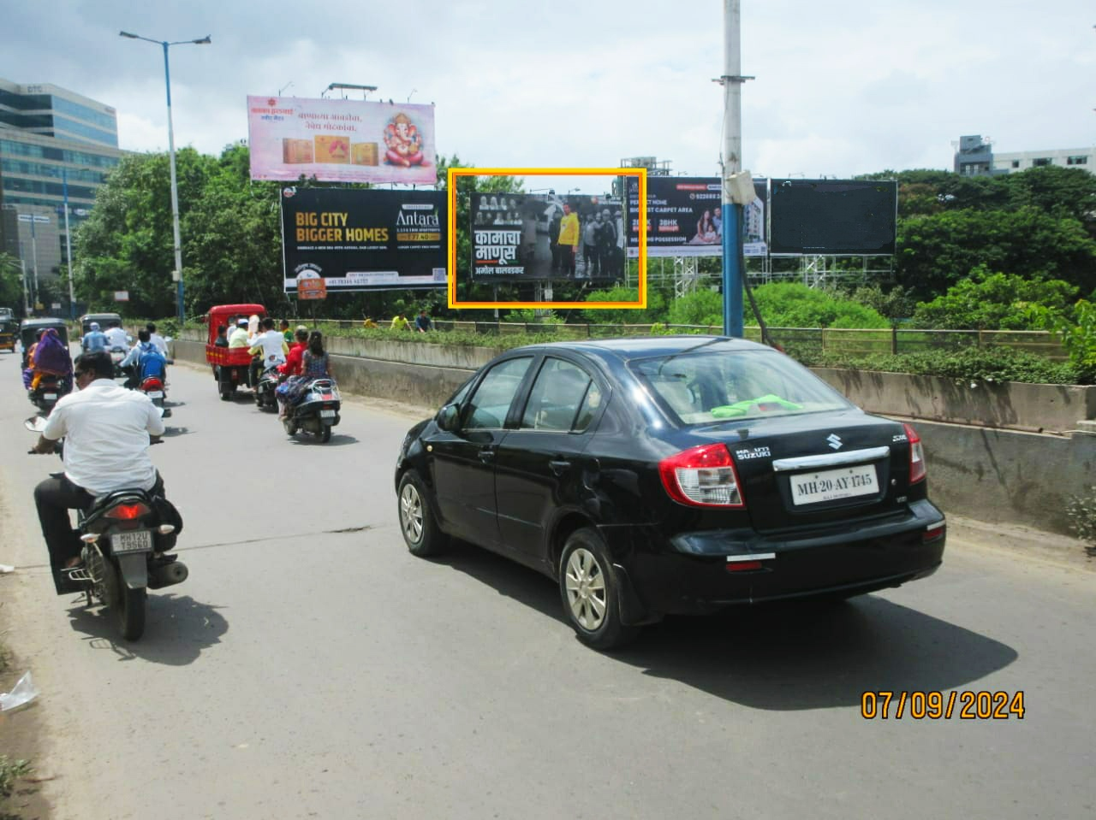
Mhatre Bridge Fcg Lbs Road Towards Nalstop Chowk 40 X 20 Lit

Slide 41
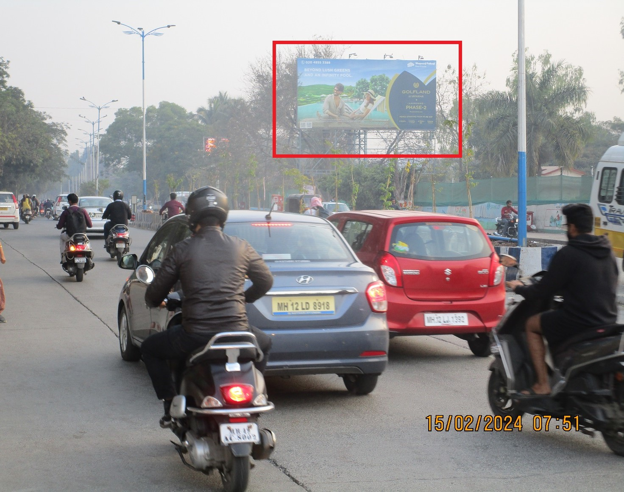
Rajaram Bridge Facing Sinhgad Road To Dp Road, Karve Nagar 40x20 Lit

Slide 42
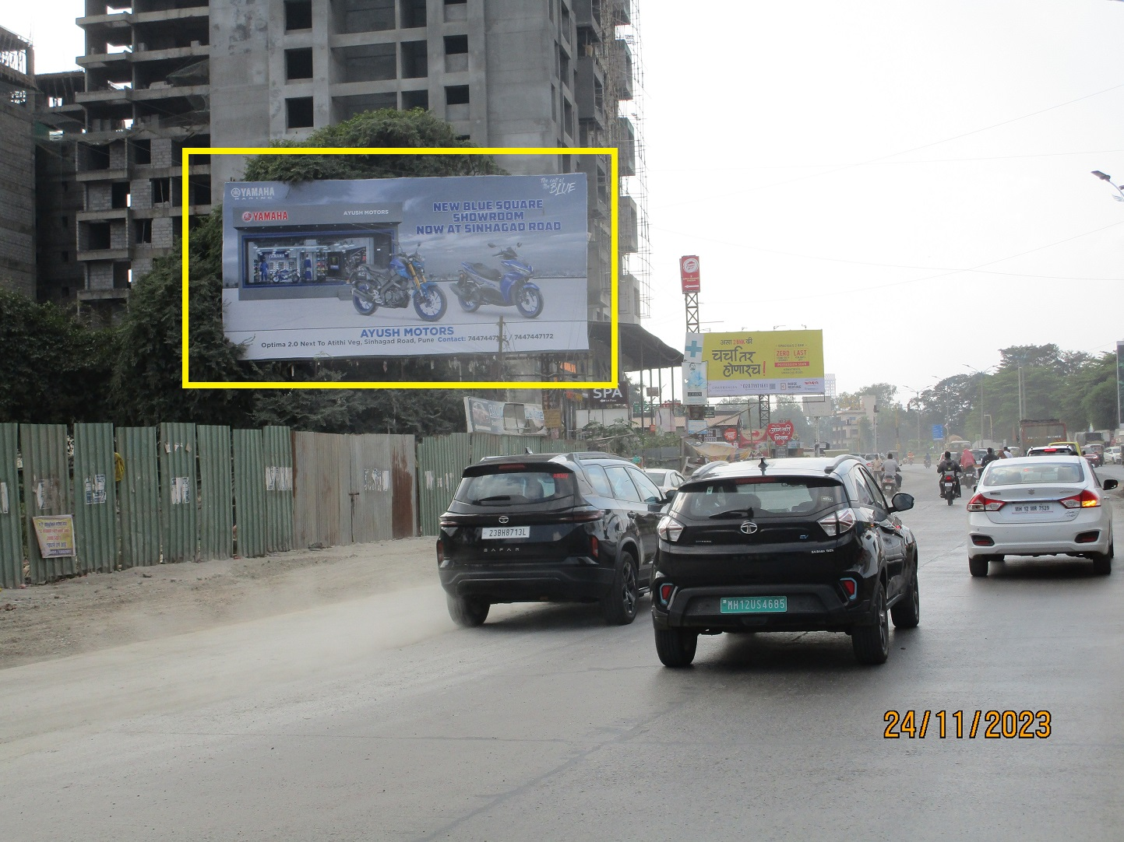
Sinhgad Road Nr. Nanded City Facing Dhayari To Khadakwasala 40x20 Nl

Slide 43

Terms & Conditions
Flex Printing & Mounting charges Rs. 12/- per sq. ft.
We will not be responsible for flex damage due to any natural calamity..
GST Tax Extra @ 18% on Display Charges & Flex Fixing.
Purchase order is required at the time of site booking confirmation
Billing date will be the date of booking as per the purchase order Confirmation.
Site once booked cannot be cancelled / postponed.
If client wants to cancelled the site during contract period must inform minimum one month in advance.
Payment in Advance.

Slide 44
For More Info
+91 83088 88501

